Slide 1
An outline of the 20° EPA Congress and Exhibition 12-14/9/2022 - Brussels
Laurence A. Bannerman
European Parking Association

Slide 2
In 2022:
EPA will be celebrating 39 years of activity;
Holding the 20th International Congress and Exhibition in Brussels;
We are expecting more than 500 delegates from over 30 countries worldwide;
An exhibition area with over 70 exhibitors;
A top level 3 Day Scientific Program prepared by the interdisciplinary STC.

Slide 3
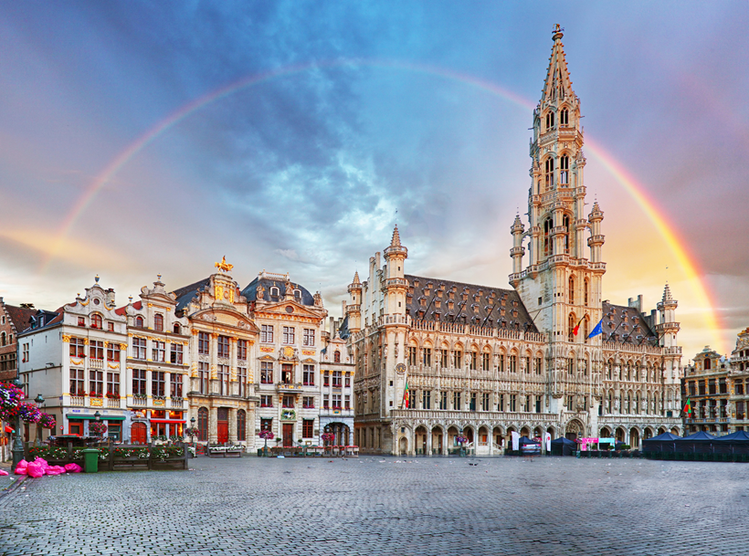
Our first CO2 neutral event – all locations within walking distance in the centre of Brussels.
Congress Center „Square“ in the heart of Brussels;
Welcome Reception at the Brussels City Hall;
Gala Dinner in a Majestic Car Park close to the Grand Place.
Notes:
.

Slide 4
Plenary Sessions:
Keynotes/Roundtables /Talk shows/Presentations
EPA EV SURVEY: the state of the art of the transition to electric mobility
EU Green Deal from the European Commission
Future of Parking in a disrupted Mobility Urban Scene
Mobility, Infrastructure, Urban Planning, Citizens
Post Covid Models - Disruptive situations, new opportunities, integration
2021-2022 EPA Awards Ceremony
7 different award sessions – EU State of the Art

Slide 5
Parallel sessions
Digitalization- Connectivity – APDS
New Business Models
UVARS: relationship between access management and parking management
Young Urban Parking Professionals
Park4SUMP
Curb Side Management - On Street Parking
Mobility Hubs - Off Street Parking
Managing Urban Logistics

Slide 6
See you in Brussels in September 2022 Early bird date 25.03.2022 www.epacongress.eu

