Slide 1
Parking Data Standards - The key to integration
Keith Williams
Alliance for Parking Data Standards

Slide 2
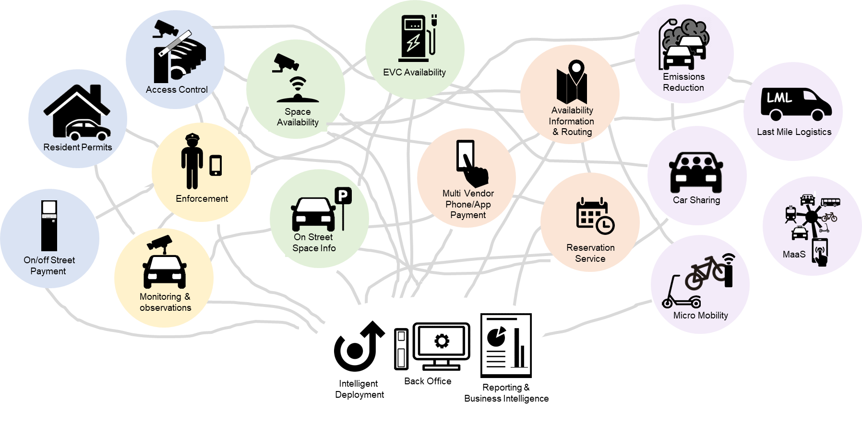
The Integration Challenge

Slide 3
Benefits of using a standard
Clear specification of data to be shared (common ‘language’)
Open Standard protocols – ready to meet the needs of each integrator
Reduced cost of integrating (one time integration for each supplier)
Greater potential for systems to work together for 1st time
Result: Easy & reliable connections between independent systems

Slide 4
APDS – A standard for Sharing Parking Data
Developed by the Parking Sector in 4 continents
Not for profit
ISO & CEN versions
Aligned with other standards (DATEX II, AVPS) and linking beyond parking (EVC, Kerbside Management)
Dynamic – being developed to meet new demand

Slide 5
Standards in Procurement
Benefits
Risks
Reduces the size & complexity of tender specifications
Helps create clear requirements
Understood by Suppliers
Reduces costs
Drives ambition & innovation
Using the wrong standard
Lack of adoption by sector
Non-compliance by suppliers

Slide 6
Multi-Modal Payment A Practical Standards Example (UK NPP)
0
1
2
W
W
W
0
2
3
2
W
0
1
W
W
Parking System Providers
Commercial Operators
1
2
2
3
0
W
Planned Integrations
0
1
2
W
W
Public Sector & Local Authority Operators
2
0
1
W
W
0
1
2
0
2
W
W
Service Providers
National Parking Platform Pilots
0
1
W
W
1
2
0
1
W
W
1
0
W
W
1
2
0
Parking Availability
0
W
1
2
Data Providers
1
Payment on Arrival
Enforcement System Providers
0
2
ANPR Frictionless Payment
1
2
0
W
3
Pay on Departure by App
0
0
W
Public Sector Working Group Member
1
2

