Slide 1


On-Street Parking & Kerbside Management Tools
Thierry BRUSSEAUX

Slide 2


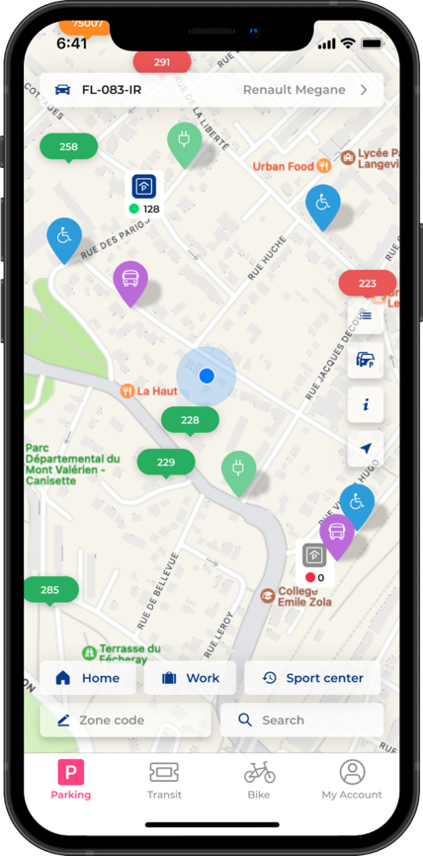

ON-STREET PARKING
OMNI CHANNEL USER INTERFACES
to manage the allocation and payment of the kerbside use for an ACCESSIBLE and INCLUSIVE City
User & Vehicle types
All payment means
Map based Offer &
Regulation
All sales channels

Slide 3
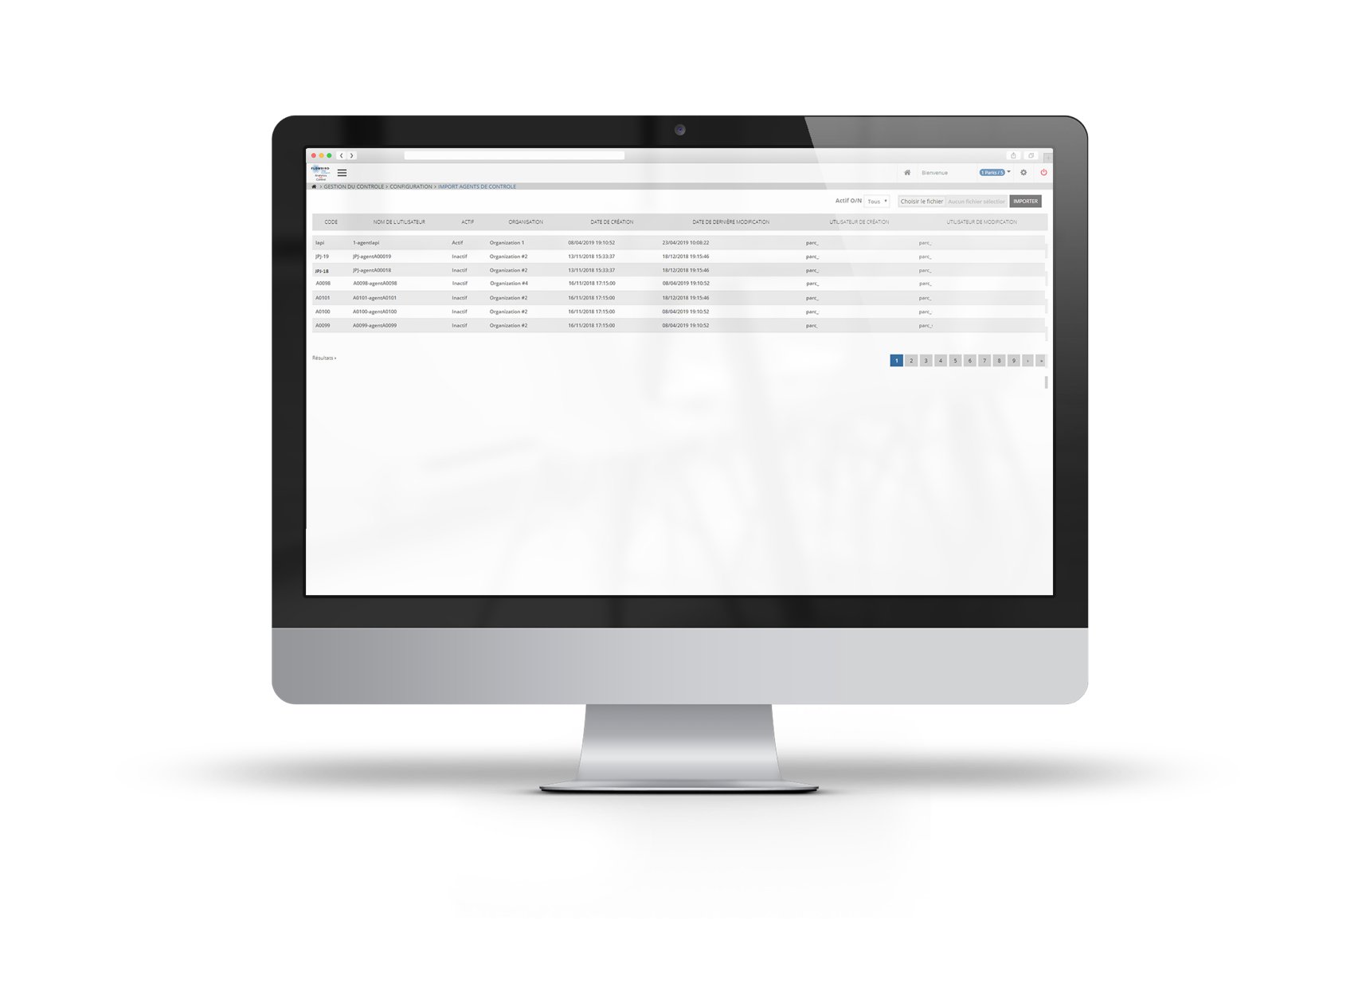
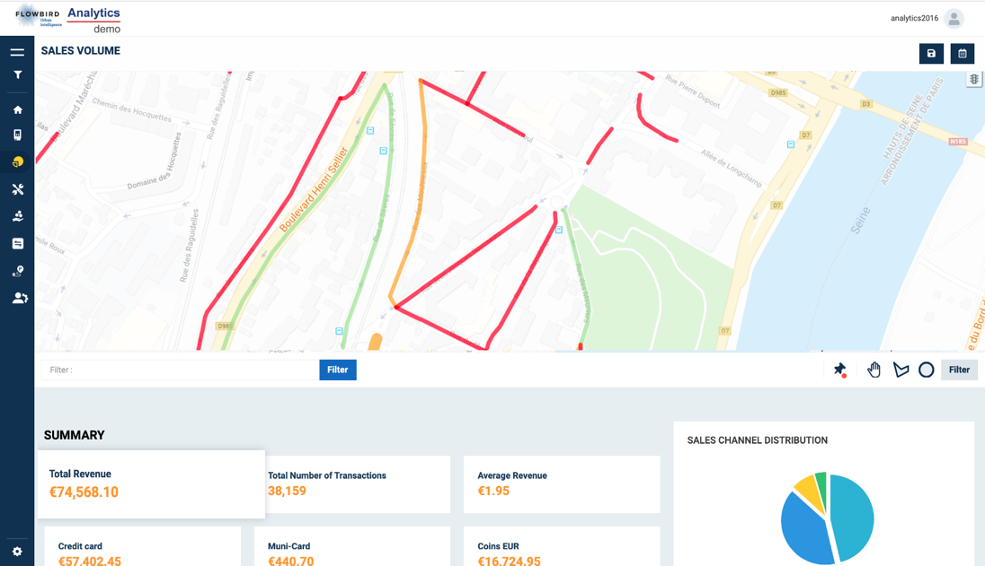
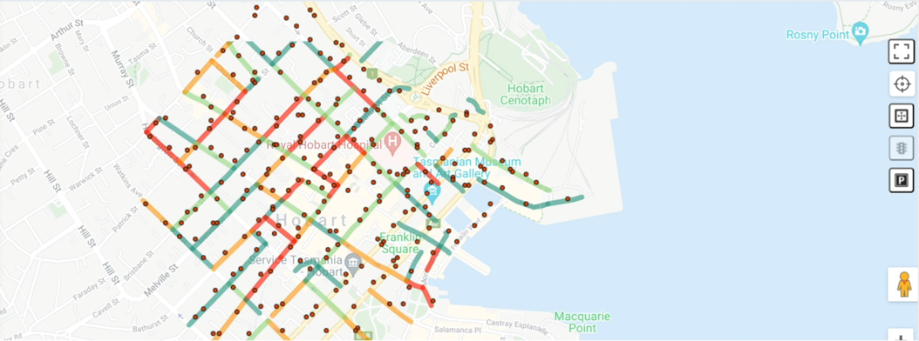
DIGITAL ON-STREET PARKING MANAGEMENT
allows Local Authorities to set up and control kerbside use to facilitate modal shift for SUSTAINABLE MOBILITY.
Kerbside mapping
Shared & allocated spaces
Regulation: tariffs and rights
Map based
User & Vehicle types
Mobility mode
Financial consolidation
Asset management
Monitoring
Tickets, uses
Control, respect
Analytics
Open data

Slide 4

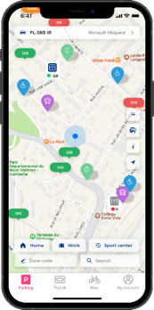
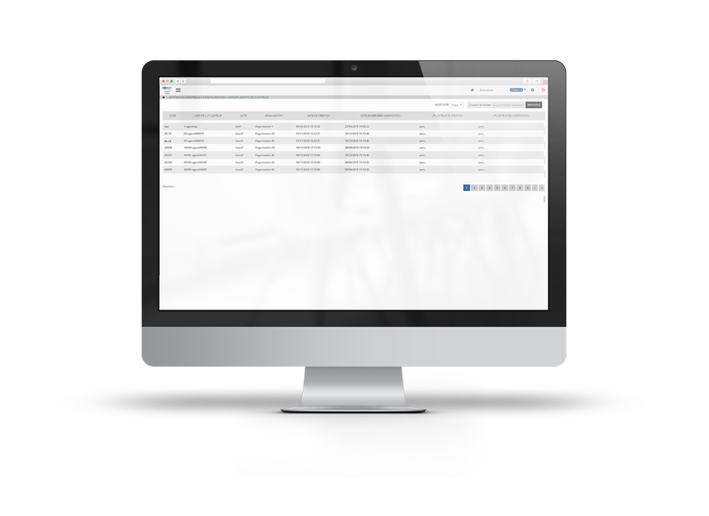

Digital
Parking HUB

Slide 5

Contact : thierry.brusseaux@flowbird.group

