Slide 1
for Colchester

Slide 2
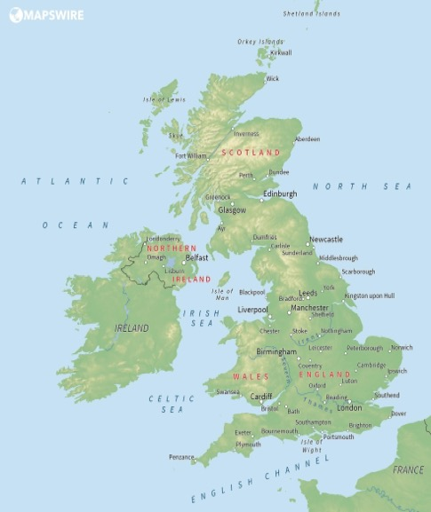
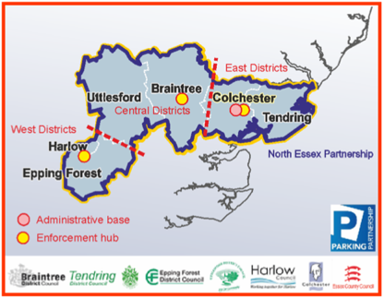
Richard Walker Group Manager
North Essex Parking Partnership
Colchester is located in Essex, in the East of England and is less than an hour north of London

Slide 3
Background
Location Criteria
Overcoming barriers
Launch of first scheme
What’s next?

Slide 4
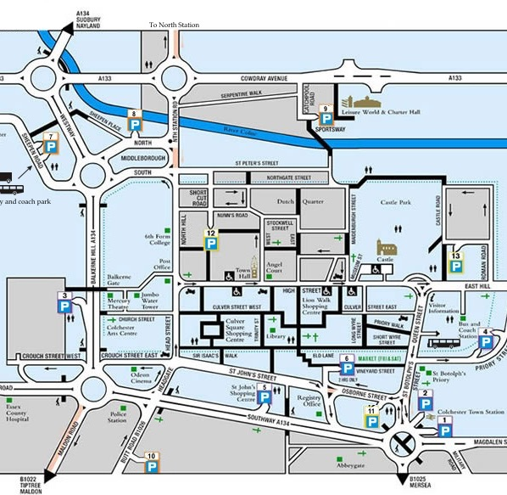
background - benefits
Roman grid pattern difficult ‘last mile’
Social Distancing & Active Travel town centre road narrowing/layout
New Cycle Routes north/south & east/west links
Long stay market new uses: pandemic changed forever?
Rail Station, Hospital, Park & Ride cross-town options from south & east to north
>5 mins

Slide 5
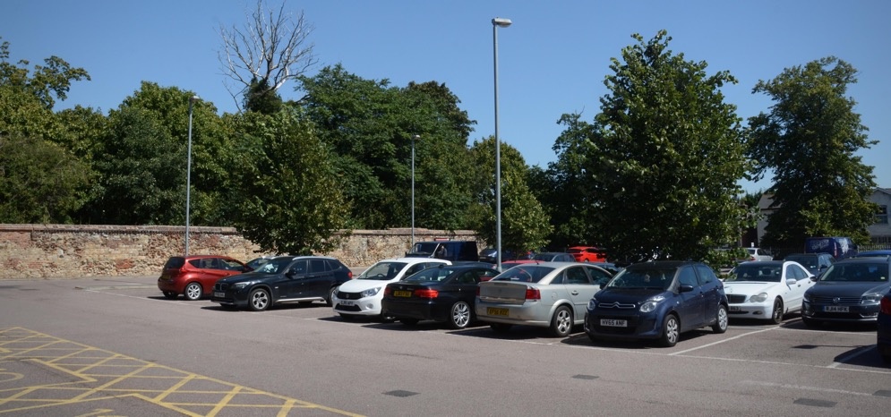
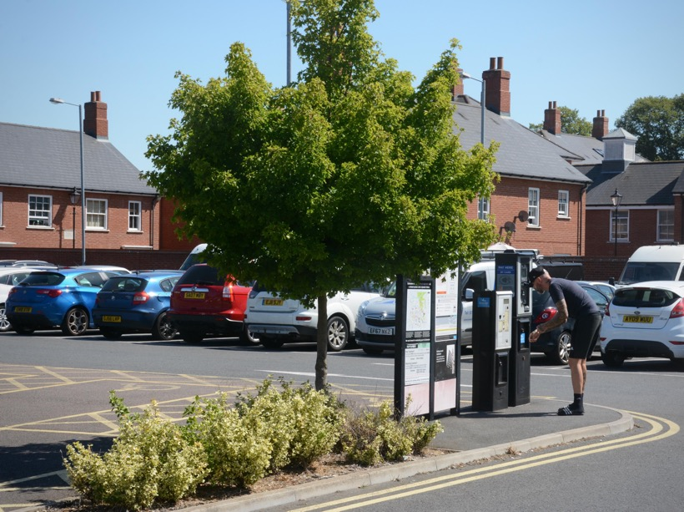
the locations - criteria
Long Stay car parks 5 min+ walk to town centre, with space
Provision for facilities cycle hubs/click & collect delivery
New Cycle Routes nearby links to other parts of town
Rail Station, Hospital, Park & Ride cross-town options

Slide 6
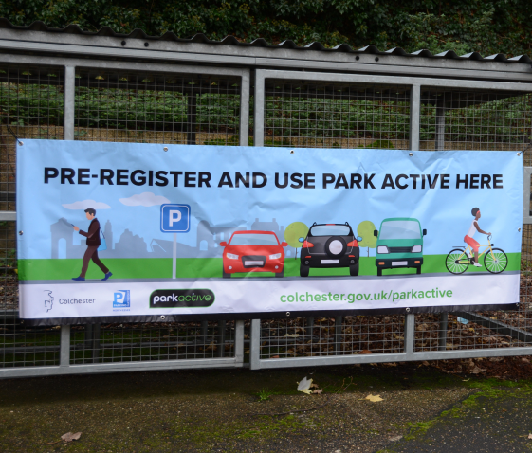
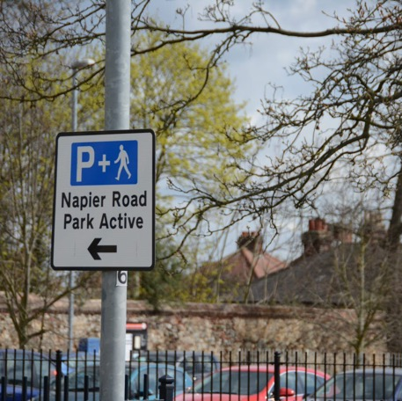
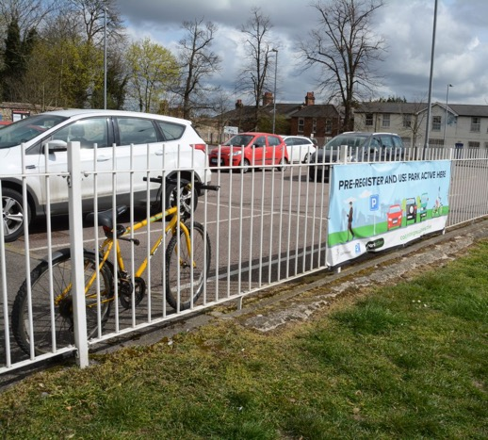
hurdles - overcoming issues
Highway signage signage design & special authorisation
Communications banners, web page, social media, press
Sign up and Community hosted in App with direct communication
The Parking Offer better prices than town centre parking available through the App

Slide 7
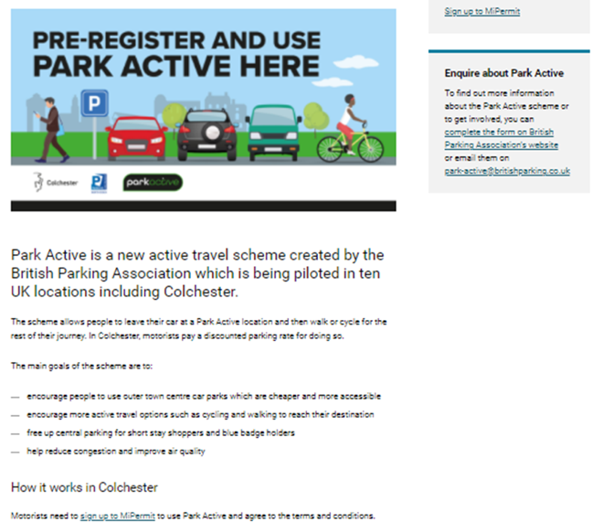
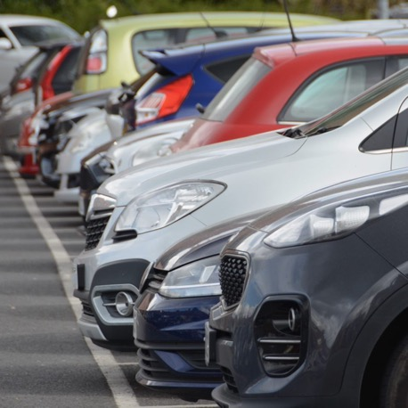
launch
30 November 2020 & April 2021
Tariff charged is via App distinct T&C and special area in MiPermit we can then measure success by counting…
Web Page details on website
Social Media and Press coverage / soft launch from 3 December
www.colchester.gov.uk/parkactive soft launch 30 November 2020 Fully launched from April 2021

Slide 8
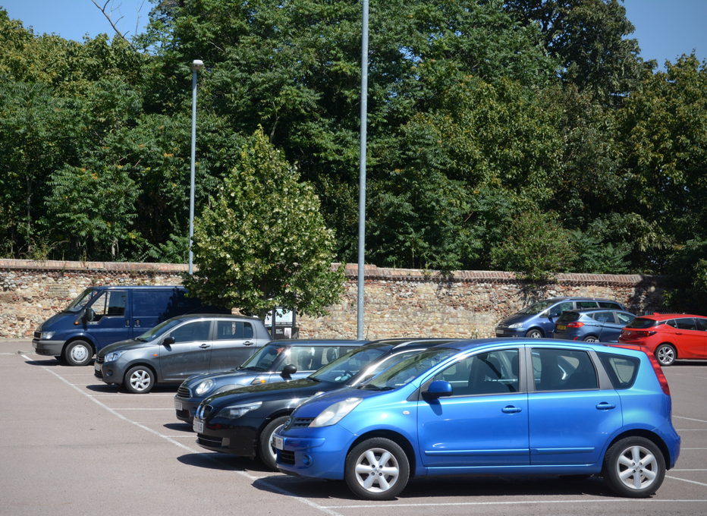
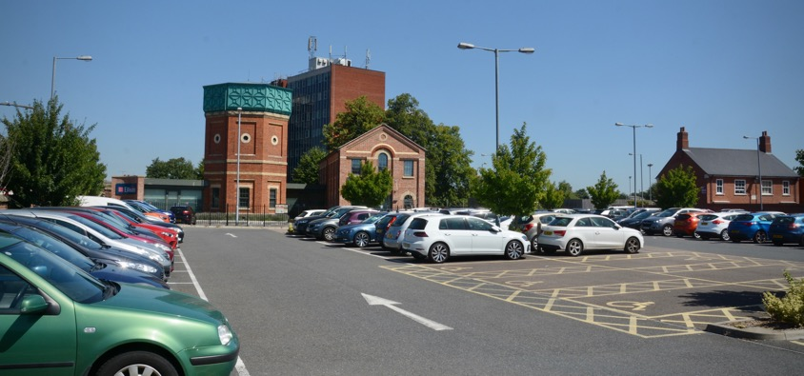
what next?
Park Active
Secure cycle parking different options at Park & Ride
Park & Choose: Hospital, rail station, football ground links to cross-town routes & active travel
Click & collect; town centre cycle hub e-cargo bikes to deliver to car parks improving cycling provision
Work with the Community develop offers & work with shops
Improvements…. Signage, maps, walking time data collection & evidence

Slide 9
for Colchester

