Slide 1
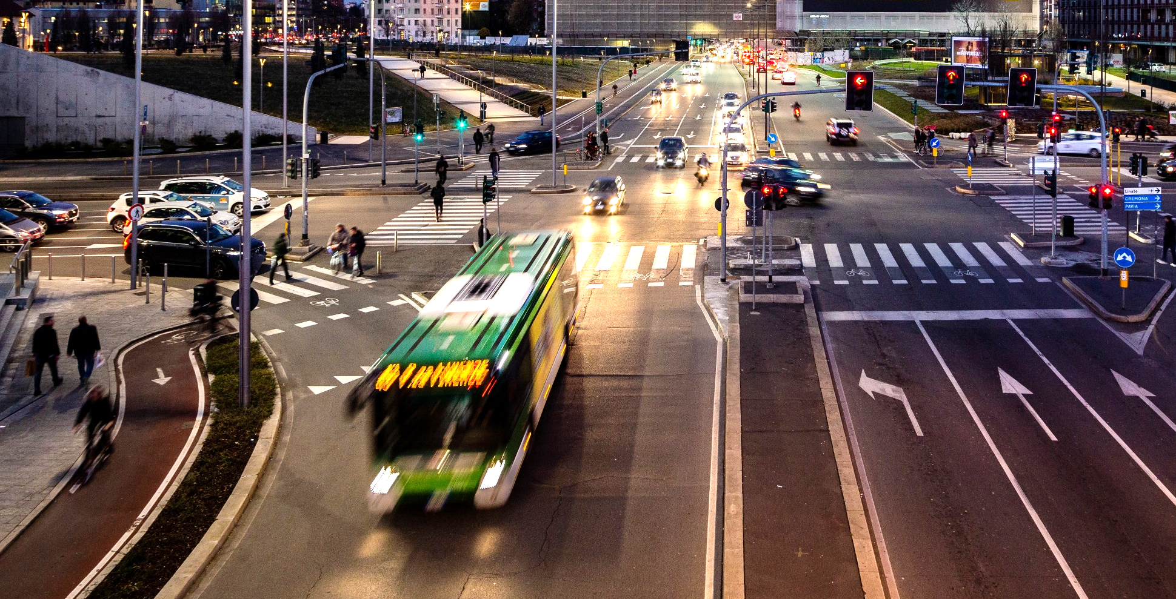
Mobility Ecosystem
The City of Milan: the centralized mobility platform managing and implementing integrated parking services supporting mobility strategies
www.atm.it
Infoline ATM 02 48607607
atm_milano
atm_informa
ATM Milano Official App
06th October 2021
Roberto Carreri, Research, Development and Digital Innovation Manager
Annalisa Nuovo – Responsabile Applicazioni di Mobilità e Sharing
Roberto Carreri – Direttore R&D e Innovazione Digitale

Slide 2

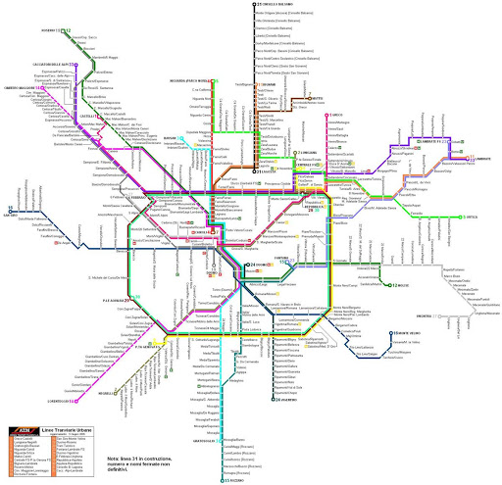
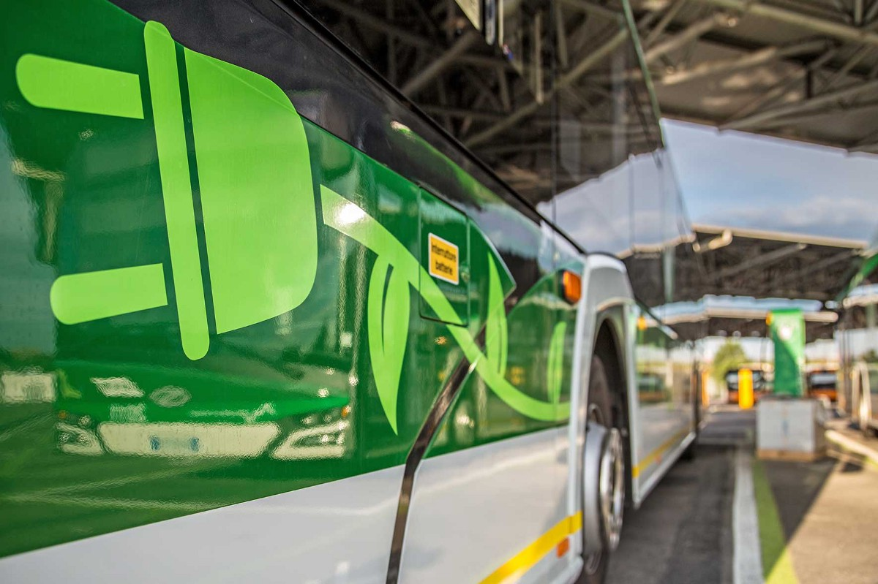
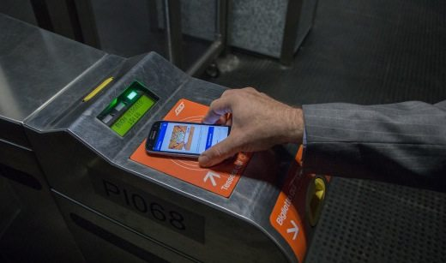
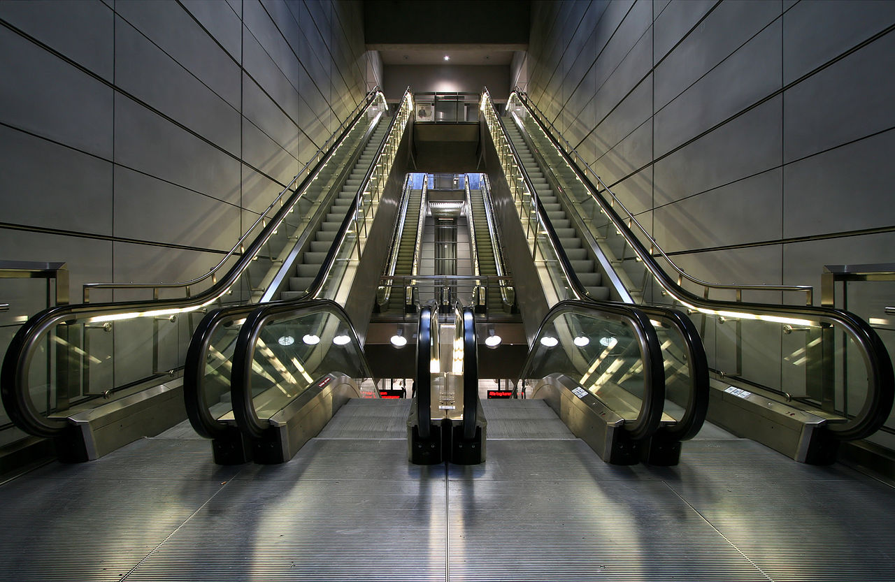
ATM Group
Joint Stock Company owned by the Municipality
Of Milan
Public Transport
Company in Milan
and in 96 Municipalities
Innovative Service and System for sustainable mobility
Technology and digital transformation
for Smart City
International Development

Slide 3
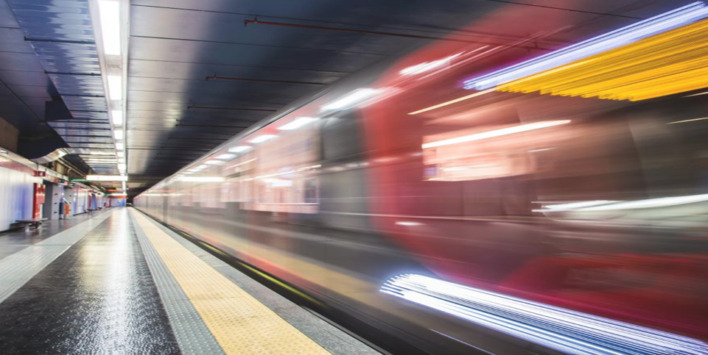
ATM Group:
Our numbers
1 billion€
Revenues
95
Municipalities served
10.000
Employees
800 mn
Passengers trasported per year
185 mn
Km travelled per year
70%
Km travelled with
electricity

Slide 4
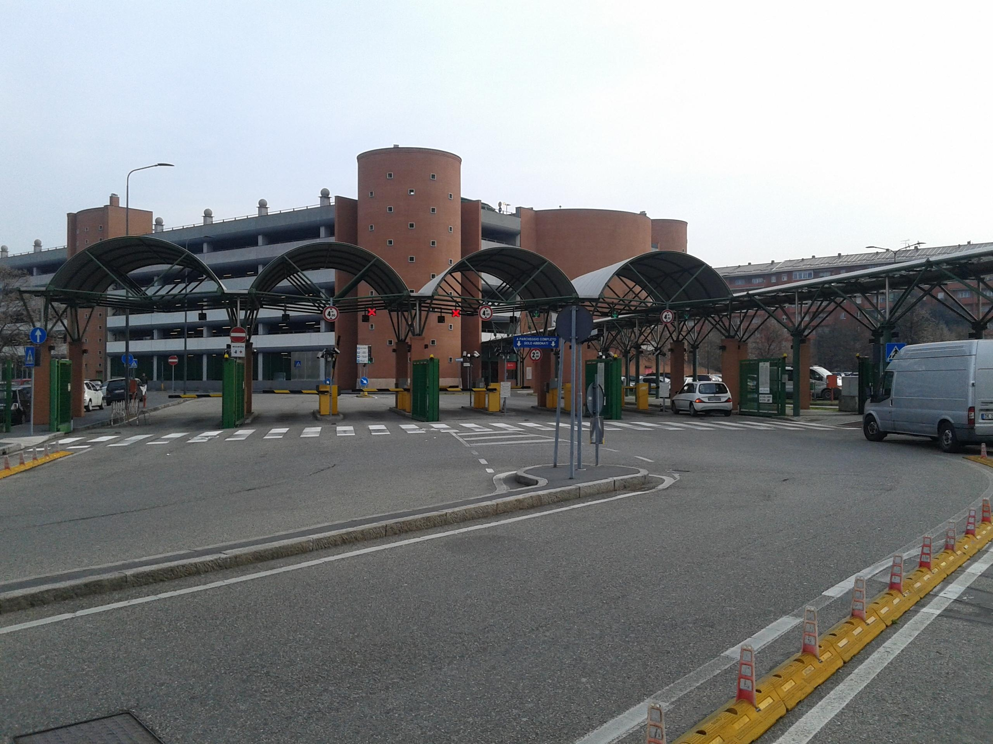
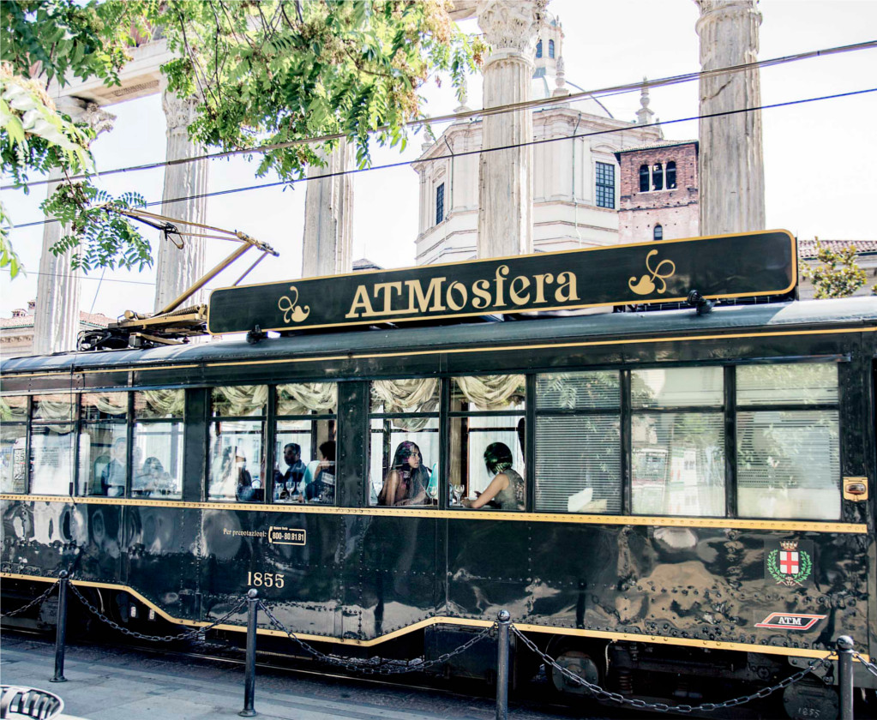
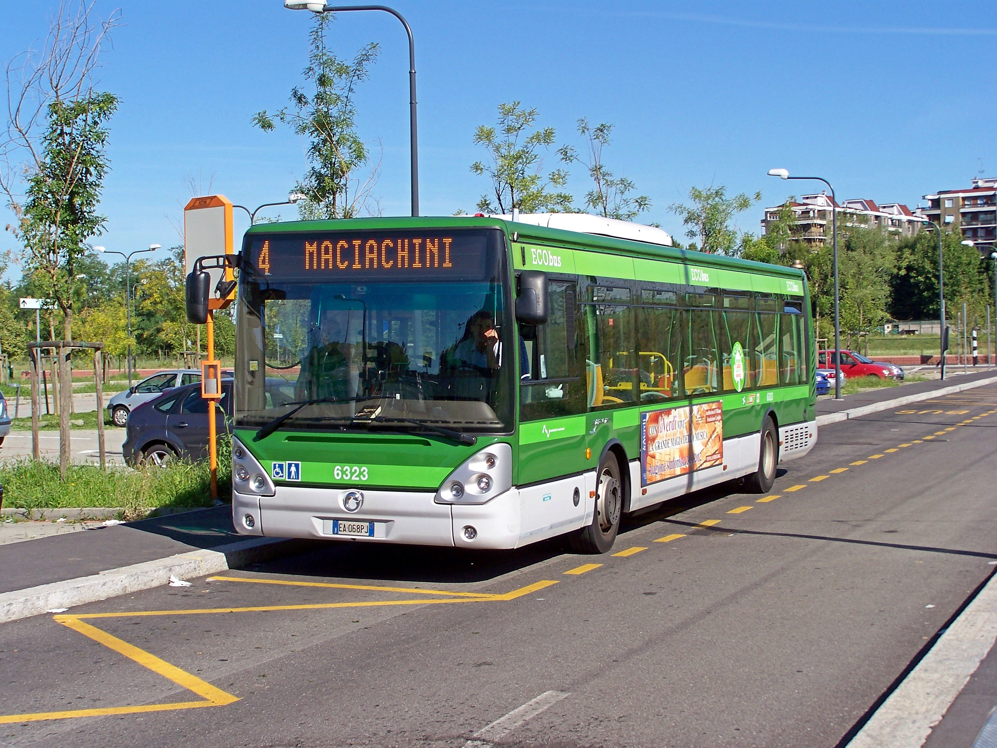
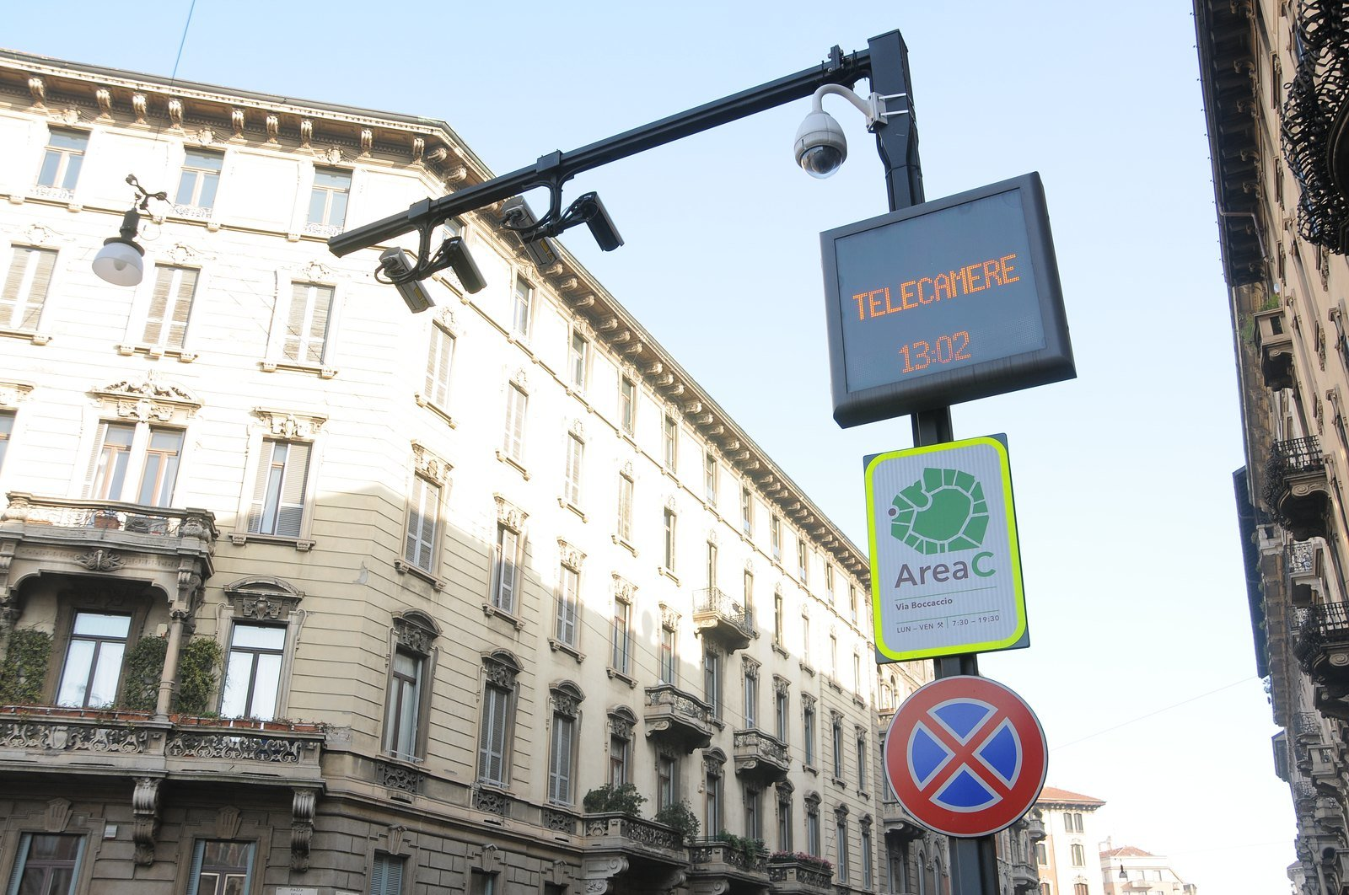
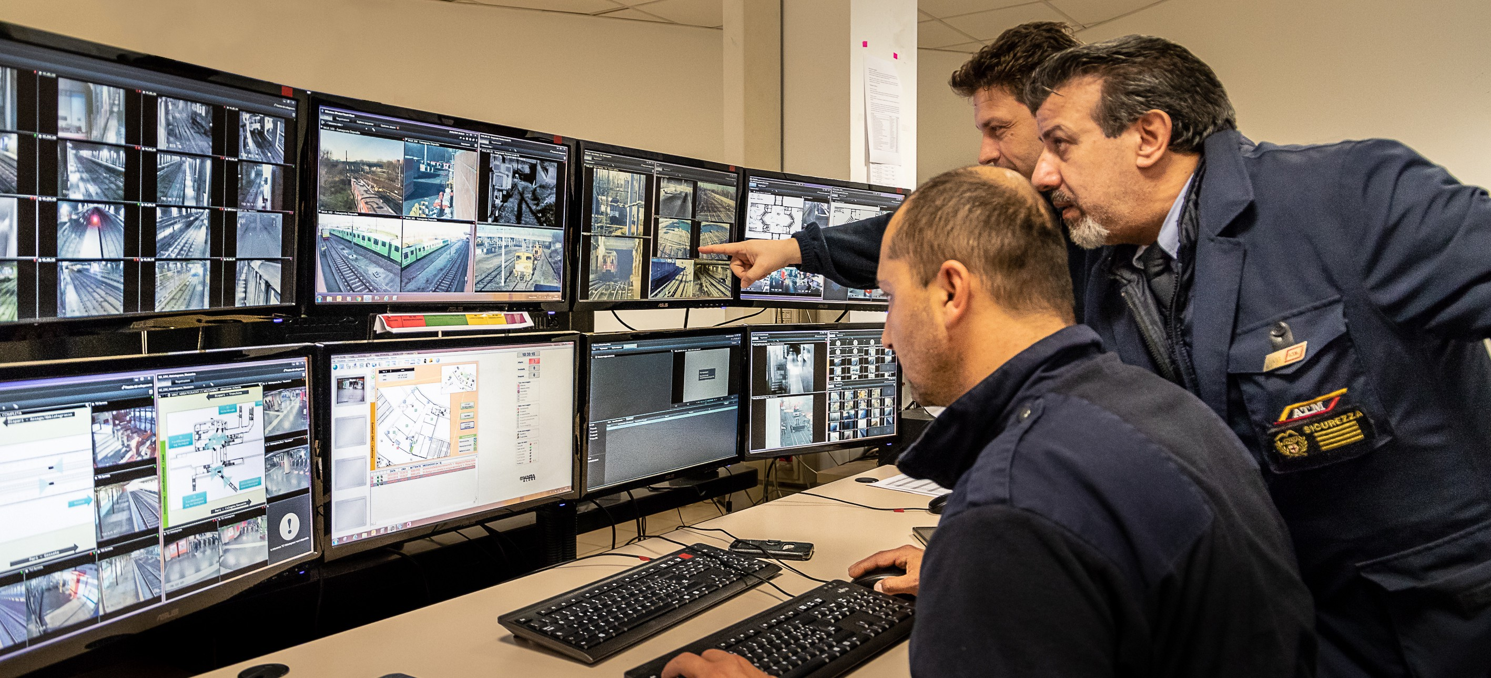
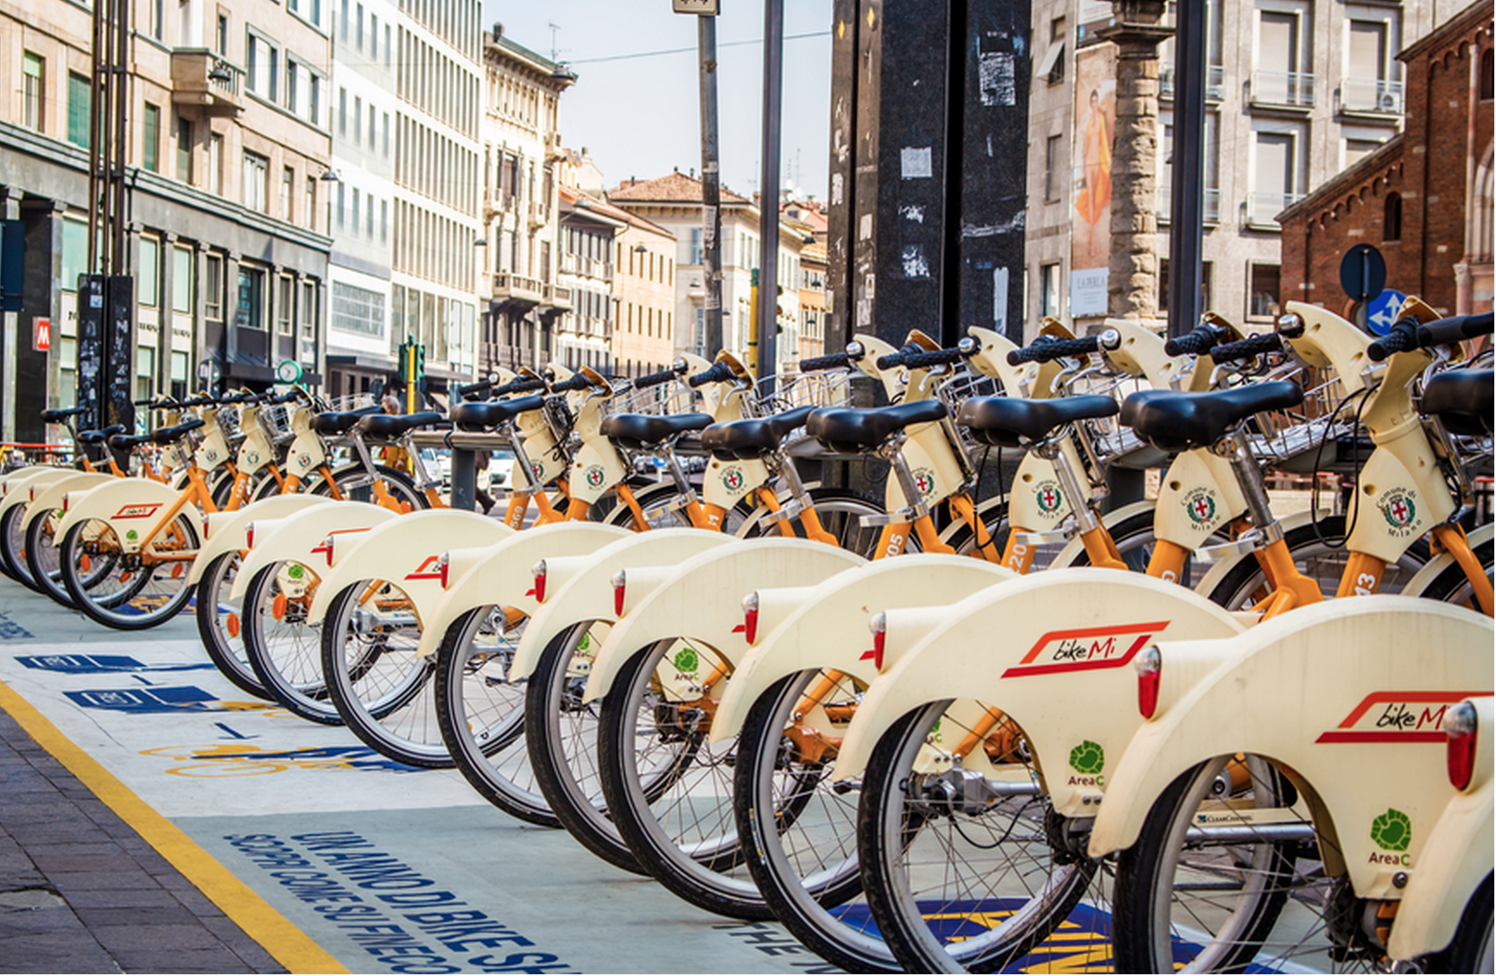
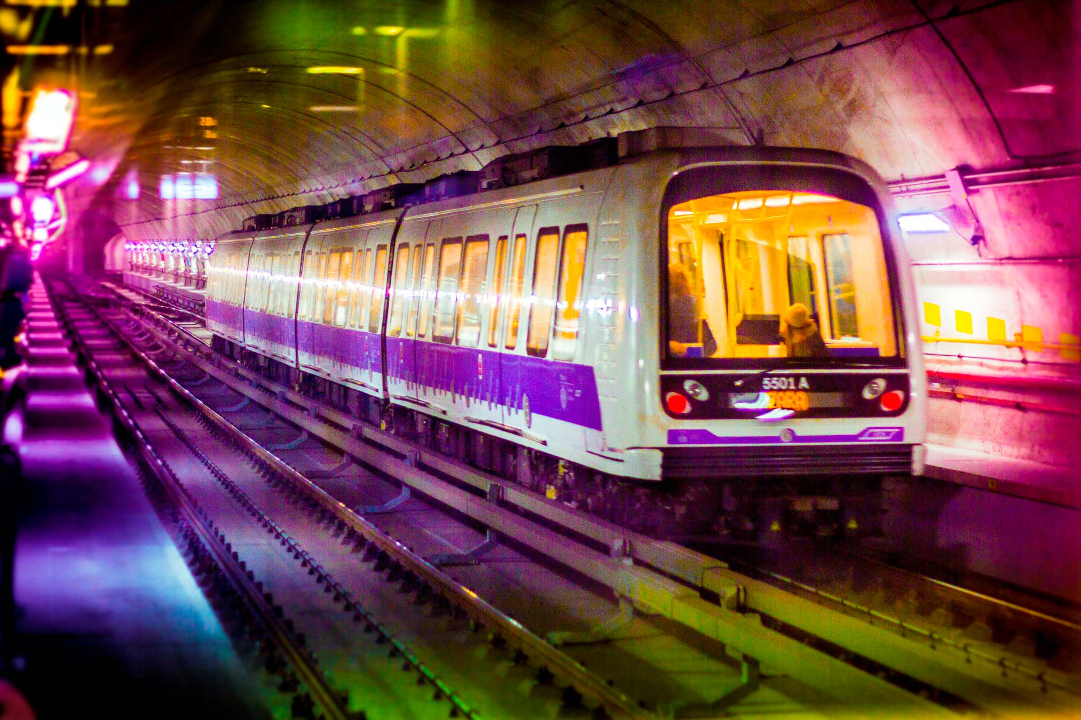
ATM Group: Activities
Parking lots and infrastructures
Tourist Services
Urban and suburban public transport
Mobility Technology Management (congestion&
pollution charge)
Fleet Diagnostics and maintenance, infrastructures and technological networks
Bike sharing
Driverless Metro

Slide 5
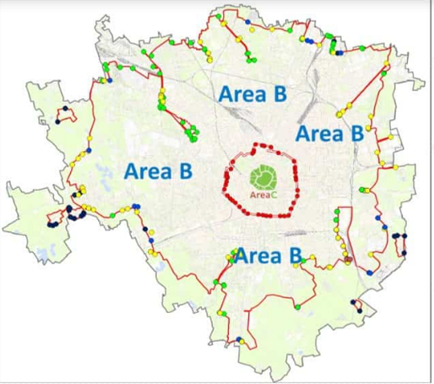
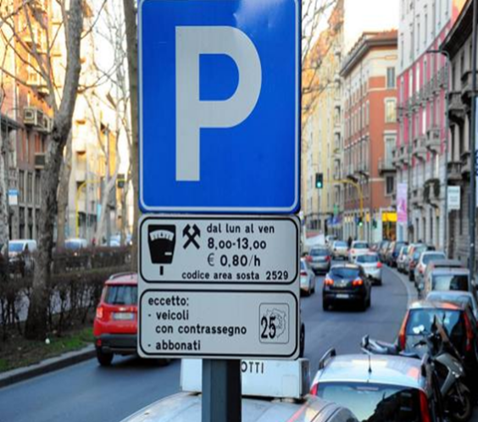
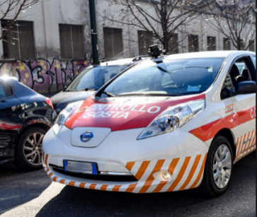
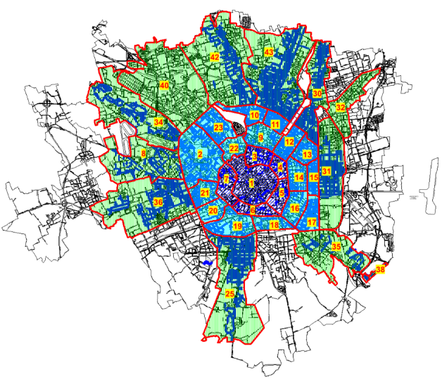
Main topics
  Parking lots: point of arrival or new departure?
  A journey through Milan’s mixed mobility ecosystem
  Interactions between its elements
  Parking and Sustainable Mobility: an opportunity for MaaS evolutions
5

Slide 6



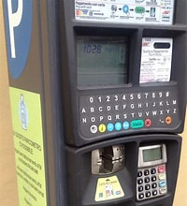
Journey into Milan Ecosystem Mobility
    Signage?
    Prohibition?
    Permit?
    Prohibition?
    Permit?
    Pay the ticket
    P yellow road strips
    (Permit – for free)
    P structure
    Check
    Area Gate B
    Area Gate C
    To Park
    P blue road strips
    (Permit or Payment)
Notes:
6

Slide 7
Modules and interactions in one word: Operations
    Signage?
    Prohibition?
    Permit?
    Prohibition?
    Permit?
    Pay the ticket
    P yellow road strips
    (Permit – for free)
    P building
    Check
    Area Gate B
    Area Gate C
    To Park
    P blue road strips
    (Permit or Payment)
    Access Control Management
    Payments Channel Management / Concessions Process
    Permission delivery process management
    Roadside Inspection and penalty process
Notes:
7

Slide 8

Digital Transformation: an essential step
To think of an Integrated Mobility Ecosystem it is necessary to analyze the processes and
identify the interacting and cooperating ones.
To create efficiency and effectiveness, it is essential to allow access to all information
in a transparent and transversal way.
Digital Transformation
Transits/accesses
controls
Permissions
Backoffice
& Operations
Payments
Notes:
8

Slide 9
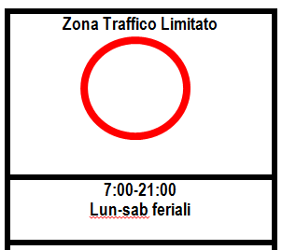
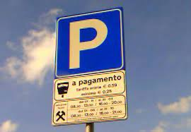
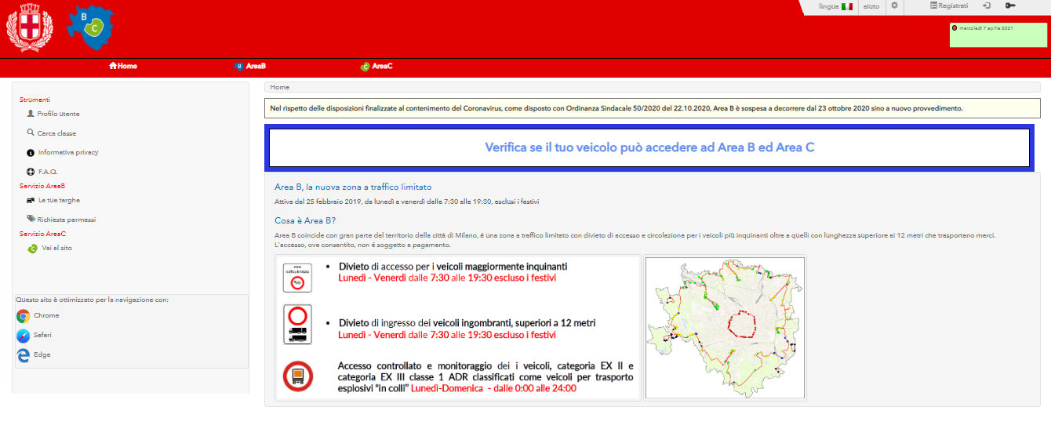
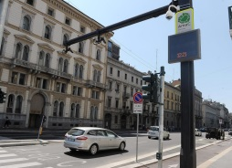










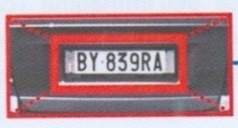
From Parking to MaaS: how to?
CHECK
185 Electronic gate and Eagle Eye
INFORMATION
FRONT-END
Parking strategy:
a new booster for
MaaS
«Account based journey» centric
«Plate centric»
«Plate based»
vs
BACK-END SYSTEM - Operations
PAYMENTS SYSTEM
EXTERNAL Datasources
To check the technical data of the vehicles
Notes:
9

Slide 10
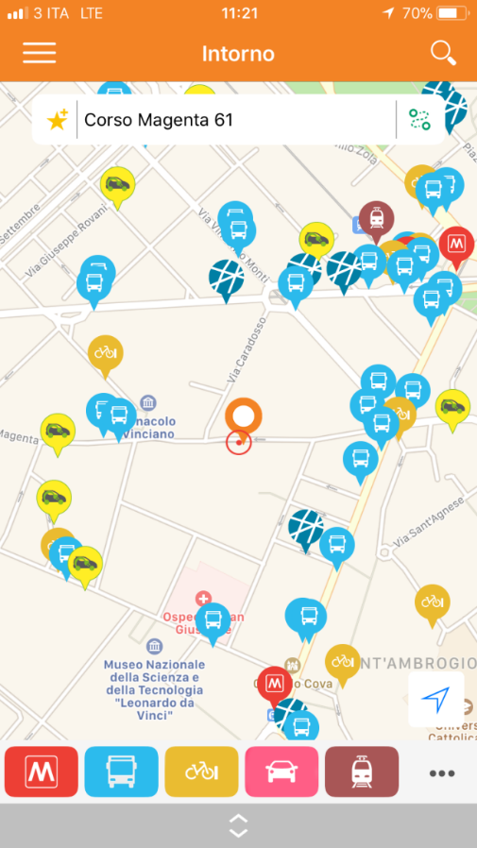








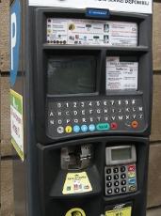
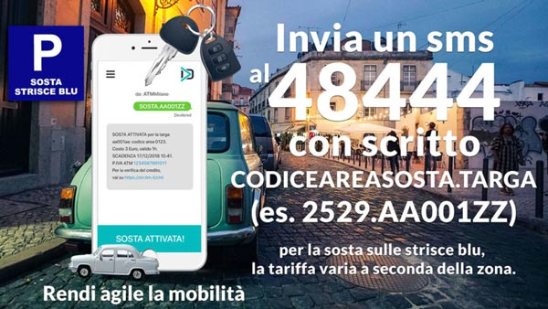
MaaS is a “journey centric” experience
Construction of an integrated platform to share data and information, to offer users the best mobility solutions
Bike Sharing
LPT
Bike Sharing
LPT
MaaS
Airports & Flight plans
Car Parks
Car Sharing
IoT sensors
Trains
Trains
Street Parking
Street Parking
A system to have both travel information and fares
Cong&Poll Charge Area
Integrated payment solutions
Payment Gateway - Clearing

Slide 11
Benefits
Sustainable Mobility offering a service that allow you to reduce the environmental impact with faster and more efficient travel
Data for monitoring, analysis,
planning, strategic choices
Demand and predictive analysis, business definition and plans available for municipal decision makers about fare-logic
Digital services that easily allow a citizen to apply for a permit. Controls with external platforms that speed up the process of checking requirements and issuing an authorization. Thank to Mobility as a Service global strategy will make it possible to reduce physical movements on the territory in several ways.
Offer value-added services to both the end user and the administration
Cost reduction and revenue increase
Creating more effective, convenient, easy, fast and efficient services that can save time and money.

Slide 12
Follow the green evolution on
Write your purpose in pen,
your path in pencil.
ATM
atm_informa
atm_milano

